Slide 1


PLOT-TAL: Prompt Learning with Optimal Transport for Few Shot Temporal Action Localization
Edward Fish & Andrew Gilbert
University of Surrey, UK
Notes:
Hello, welcome to our presentation on PLOT-TAL: Prompt Learning with Optimal Transport for Few-Shot Temporal Action Localization, work done with my PhD student Edward Fish.

Slide 2
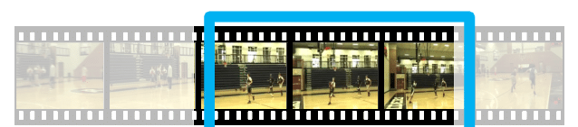
Motivation
In Few-Shot Temporal Action Localization we want to find the start and end of actions in a video given only a small number of training samples per class.
1
Notes:
In Temporal action localization the objective is to locate the start and end points of actions in continuous videos. In the few-shot case, we only see a very limited number of examples of each action.

Slide 3
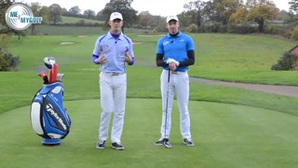
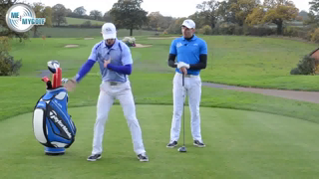
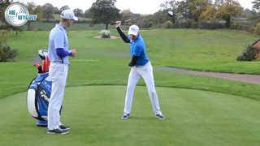
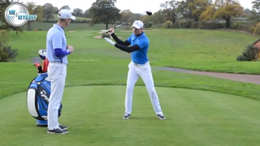
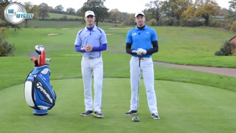
Motivation & Problem
One method for identifying boundaries is to use a Pre-Trained CLIP model to find frames that most align with a prompt.
However, CLIP is not good at discriminating between spatial and temporal features in videos.
0.7
0.8
0.7
“Golf Swing”
CLIP
0.6
🥶
0.5
1
Notes:
Zero-shot approaches have previously used pre-trained CLIP models to find frames in the video which align with prompts describing the action. However, CLIP is not good at discriminating between spatial and temporal features in videos and as such does not provide discriminative boundaries.

Slide 4
Motivation & Problem
Adding learnable contextual prompts is one way to efficiently adapt the text embedding to focus on salient actions for localization.
0.1
0.4
🔥
0.9
CTX1
+
“Golf Swing”
CLIP
🥶
0.9
0.1
1. Zhou, Kaiyang, et al. "Learning to prompt for vision-language models." International Journal of Computer Vision 130.9 (2022): 2337-2348.
1
Notes:
In the few-shot case, one approach is to add a learnable prompt token which learns salient features in the videos given the class label.

Slide 5
Motivation & Problem
We have no guarantees that these learnable prompts will learn generalisable features over just a few examples.
0.1
0.4
🔥
0.9
CTX1
+
“Golf Swing”
CLIP
🥶
0.9
0.1
1. Zhou, Kaiyang, et al. "Learning to prompt for vision-language models." International Journal of Computer Vision 130.9 (2022): 2337-2348.
1
Notes:
However, with only a few examples in few-shot learning, these prompts may learn the average of the salient embeddings which do not generalize to new contexts.

Slide 6
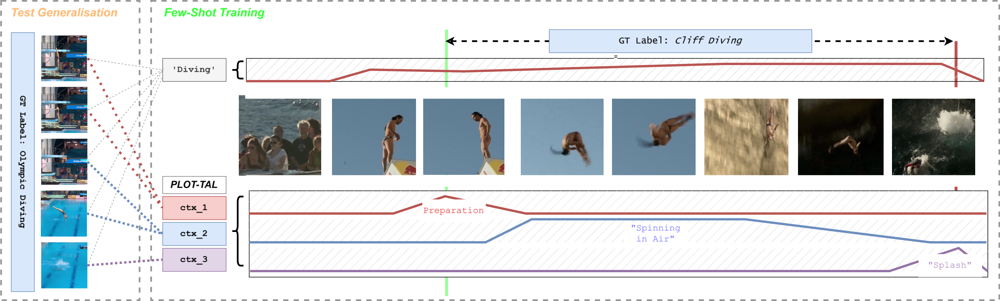
Motivation & Problem
For example, in this case we might learn the boundaries for “diving” from cliff diving videos.
1
Notes:
For example, if we learn the action boundaries of diving from cliff-diving videos with a single prompt. We will inevitably learn features such as the cliffs and sky that will not generalize to new environment.

Slide 7
Motivation & Problem
But if the diving action at test time is in a different context (Olympics), our method will fail to predict good boundaries.
1
Notes:
At test time when faces with diving in an Olympic swimming pool, these features are no-longer discriminative.

Slide 8
Motivation & Problem
Our solution is to learn multiple learnable prompts for each class which learn sub-actions which will generalise to new contexts with just a few examples.
1
Notes:
Our solution is to learn multiple prompts for each class which can learn both contexts and sub-actions from a few-samples of the activity that generalize to novel test instances.

Slide 9
Motivation & Problem
However, we need to learn these sub actions with only a few examples. How do we ensure they do not also overfit to the mean of image features.
1
Notes:
However, how do we learn these features and ensure that they do not simply regress to the mean of the visual features like the single prompt example.

Slide 10
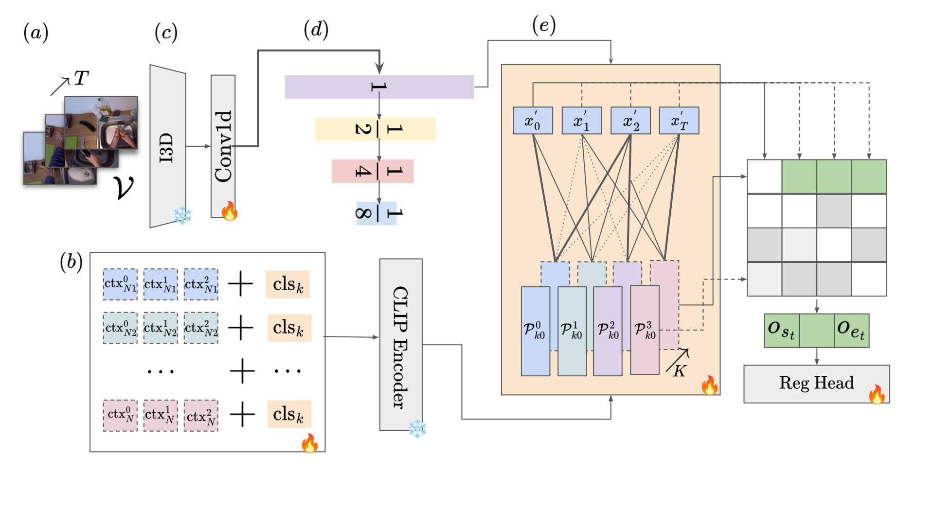
Methodology
To do so, we use Optimal Transport as a method for distributing learnable prompts among all visual features over multiple temporal resolutions.
1
Notes:
To tackle this problem we introduce a novel method for aligning prompts and visual features over multiple temporal resolutions with Optimal Transport.

Slide 11
Methodology
(A-C) We first extract T frames from a video V using a
frozen I3D encoder pretrained on Kinetics and train a Conv1D layer adapter to align these features with our CLIP text embeddings.
1
Notes:
First we extract frame level features from videos with I3D and apply a 1d Convolution to adapt the features to the CLIP text embedding space.

Slide 12
Methodology
(B) We randomly initialise N learnable prompts for each class K in the data.
1
Notes:
Concurrently, we initalise N learnable prompts for each class in the dataset.

Slide 13
Methodology
(D) We use average pooling to down sample visual features via a temporal feature pyramid creating an array of features for each temporal resolution.
1
Notes:
We concatenate all image features and then perform average pooling over multiple temporal strides to create an array of features at various temporal granularities.

Slide 14
Methodology
(E) We then compute the optimal transport plan between each temporal feature and prompt, across all pyramid levels.
The key here is that Optimal Transport algorithm includes entropic regularisation (Sinkhorn-Knopp algorithm) which ensures that the assignments between prompts and visual features are well distributed preventing collapse of prompts to one single visual feature.
1
Notes:
We then computE the Optimal Transport Plan which finds the opal weights for aligning image embeddings with each learnable prompt. The optimal transport algorithm includes entropic regularization which ensure that assignments between prompts and visual features are well distributed ensuring the prompts align with diverse features in the input video.

Slide 15
Methodology
Finally, a regression and classification head are used to predict start and end times and class labels. The transport plan is fixed, and gradients back-propagate to the visual encoder and learnable prompts.
1
Notes:
Once the optimal transport algorithm has converged in the forward pass, we fix the transport cost, multiply the cost matrix by the prompt embeddings and then perform regression and classification via two 1D CNN heads.

Slide 16
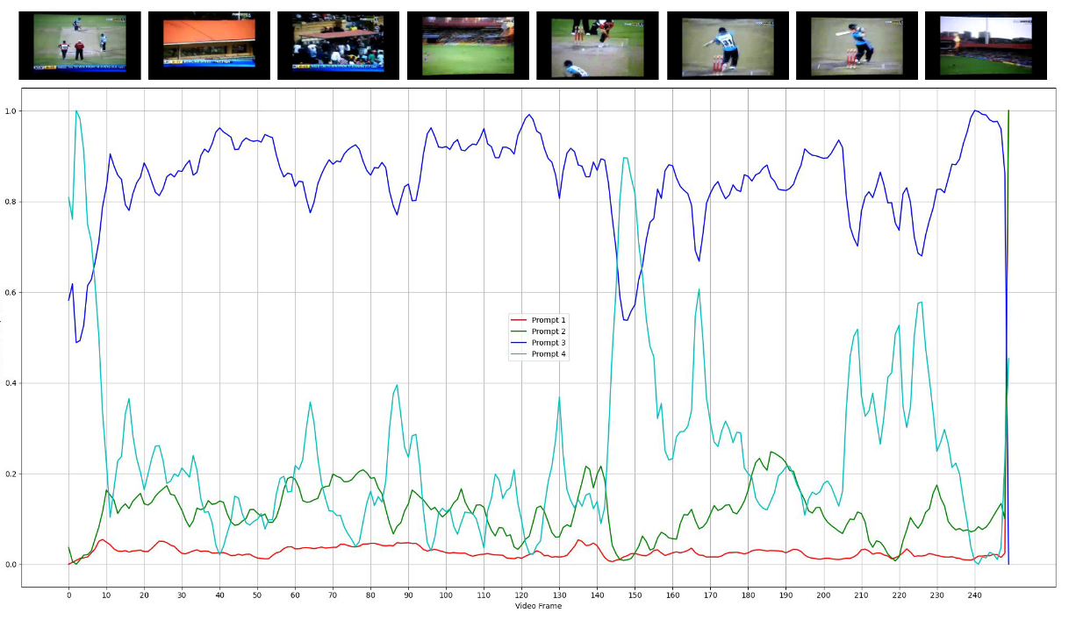
Here we can see the alignment for each learnable prompt using the transport policy. Prompts are aligned with different features across the video including the stadium and players. Cricket shot prediction is shown in green.
1
Notes:
In this figure we can see how the prompts (represented by coloured lines) are aligned with different features in the video. The green bars show where the model predicts the action of a ‘cricket shot’. Each prompt appears to specialize in different visual feature of the video such as the stadium, cricket green, and batting action.

Slide 17
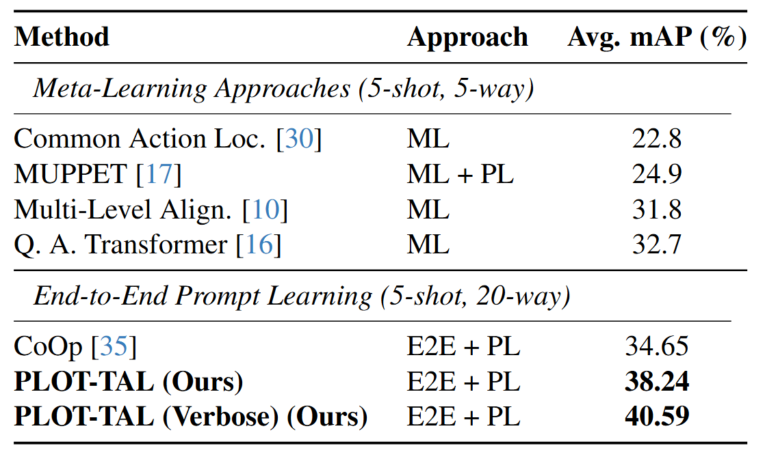
Results
Performance on THUMOS dataset. Note that we can train our model end to end (E2E) with Prompt Learning (PL) over all classes and perform better than Meta Learning Approaches.
1
Notes:
One advantage of our method is that it does not require extensive meta-learning. Instead we can simple learn all prompt tokens at training time in an end-to-end setup. We show how our model performs better than existing approaches for few-shot TAL even with this harder 5-shot 20-way training setup.

Slide 18
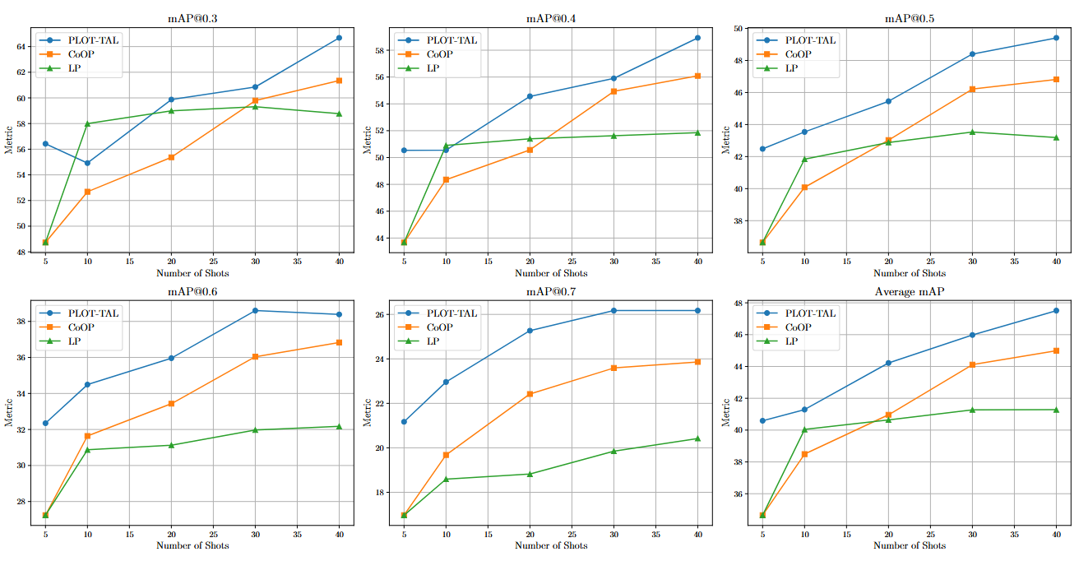
PLOT-TAL is particularly effective at high IoU with very few samples and scales well with more examples.
1
Notes:
Our method is particularly effective at high Intersection over Union and scales well as we increase the number of training samples per a class as shown on the X axis.

Slide 19
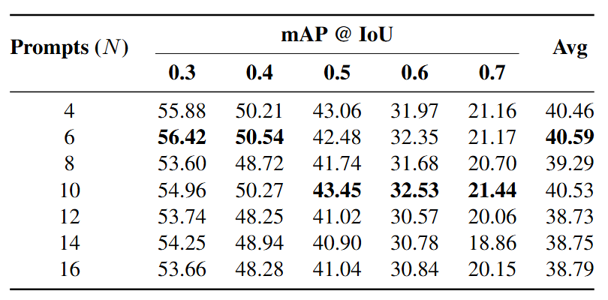
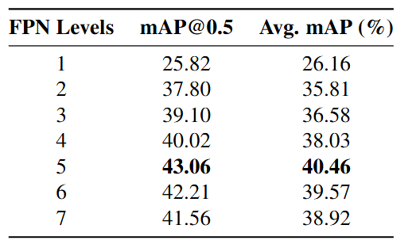
Ablations
Here we show an ablation on the number of learnable prompts and the number of down sampling layers in the Feature Pyramid Network.
1
Notes:
The optimum number of learnable prompts per class is 6 and we find that 5 feature pyramid layers is optimum for capturing diverse features over multiple resoutions.

Slide 20
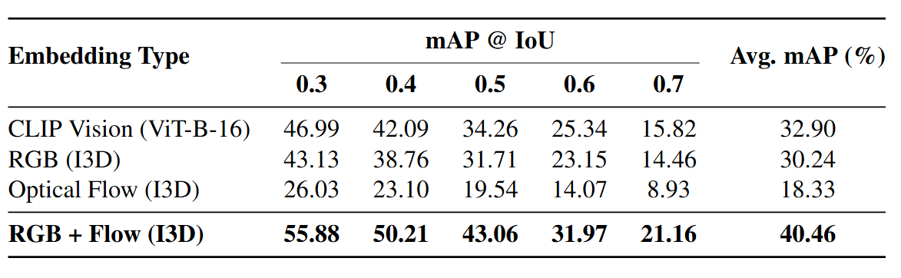
Ablations
We also show the effect of different visual embeddings. Interestingly, I3D is much better than CLIP for alignment even though we are using the CLIP text embeddings. Alignment is enabled via the 1D Convolutional layer from the image features.
1
Notes:
Finally we show the effect of different visual encoders. It’s interesting to note that I3D performs better than CLIP even though we use the CLIP text encoder. This is enabled via the 1D projection layer shown in the methodology.

Slide 21
To summarise..
Optimal transport is an effective way to align features in a few-shot setup for challenging tasks such as TAL.
Enforcing the assignment to be smooth helps with generalisation (via entropic regularisation).
We use small and efficient networks (I3D & CLIP) as a proof of concept – adapting this method to larger VLLM models would likely show even better performance.
1

Slide 22

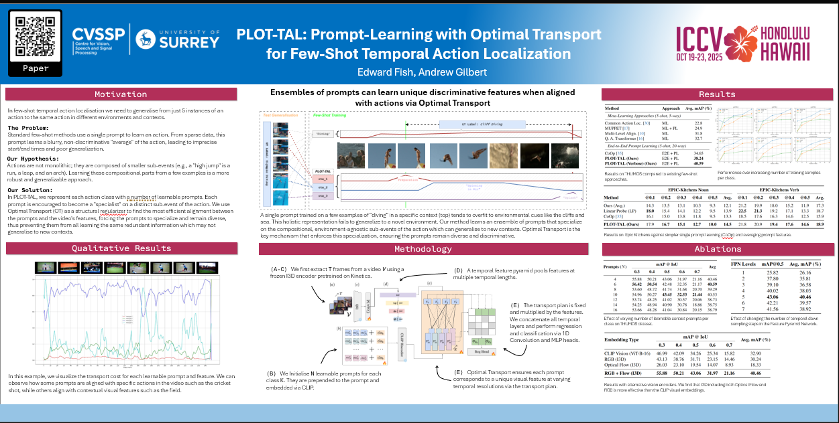
Thank You!
Edward Fish : Edward.fish@surrey.ac.uk
Andrew Gilbert: A.gilbert@surrey.ac.uk
1
Notes:
Thanks and please find us at the poster session.

Slide 23
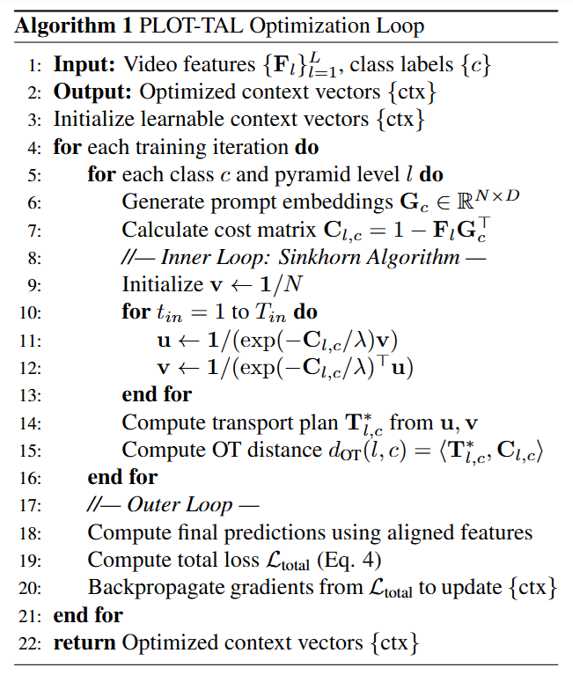
Methodology
Within the inner loop, entropic regularization acts as a crucial 'softening' factor, preventing the model from making overly rigid assignments and guiding the Sinkhorn algorithm to find a more stable, distributed transport plan.
The transport plan is computed in an internal optimization loop during training during for each forward pass.
1
Notes:
In this presentation we will cover background to sign langauge and sign langauge computer vision research as well as the aims and objectives of this PhD.
Then we will discuss work undertaken in the first year to work towards these aims.
Then condluction the presentation and discussing future work and plans.

